Slide 1



Welcome to HOU365 Saturday

Slide 2









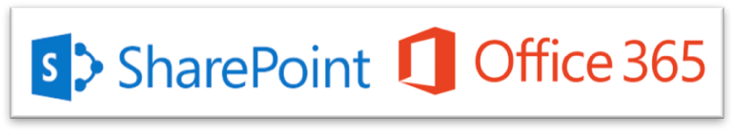


Welcome to the 10th Annual HOU365 Saturday
Formerly SharePoint Saturday

Slide 3
Turn phones off or set the ringer to vibrate
Make FOLLOW @SPSHOU on Twitter
Make sure you are in the correct room
SPSHOU Updates #HOU365
Bingo Cards are on the schedule
Visit Vendors to complete Bingo Cards
Lunch will be served at 1150-1230pm
Enjoy the presentations!
Attendee Checklist

Slide 4
HOU365.org
Officer | Individual | E-mail
President | Johnny Lopez | president@hou365.org
Vice-President | Thor Castillo | vicepresident@hou365.org
Secretary | Brian LePori | secretary@hou365.org
Treasurer | OPEN | treasurer@hou365.org
Board Chairman | Rick Garcia | Rick.Garcia@hou365.org

Slide 5
Clean up any trash/litter
Straighten up the tables and chairs
Turn off the projectors and raise the screens
Presenters, send us your decks
Please Help Us Out

Slide 6
Where is the Social?
Drinks wills be served during the Closing Sessin and Raffle

Slide 7

SharePoint Online
Customization Toolset
Alex Terentiev

Slide 8






About Myself
Custom solutions architect and lead developer in Sharepointalist Inc.
10+ years of experience with SharePoint
Extensive experience in front-end development
Regular contributor to SharePoint Patterns and Practices
SharePoint Dev Kitchen Awards: March 2017, July 2018
@alexaterentiev
http://blog.aterentiev.com/
https://github.com/AJIXuMuK
https://www.linkedin.com/in/alekseiterentiev/

Slide 9

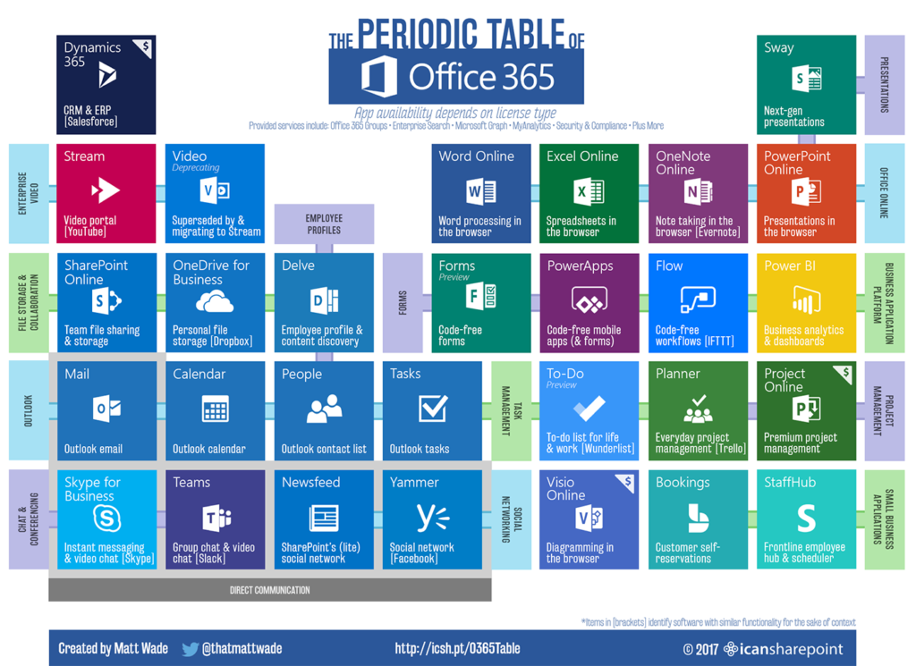


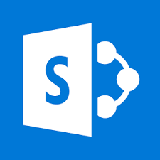








SharePoint Online and Office 365 Ecosystem
@alexaterentiev | http://blog.aterentiev.com/ | Sharepointalist Inc.

Slide 10
SharePoint Online and Office 365 Ecosystem
Nowadays SharePoint Developer/Power User(Maker) can’t think about SharePoint only. He should think about the whole ecosystem and how it can be used to achieve business goals in more efficient way.
@alexaterentiev | http://blog.aterentiev.com/ | Sharepointalist Inc.

Slide 11
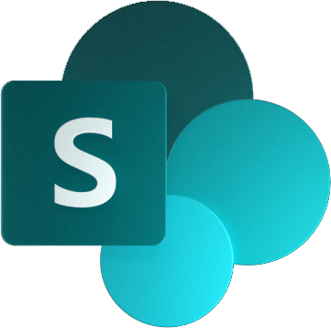
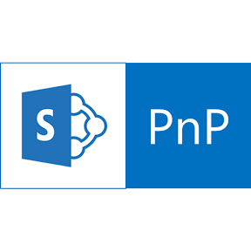

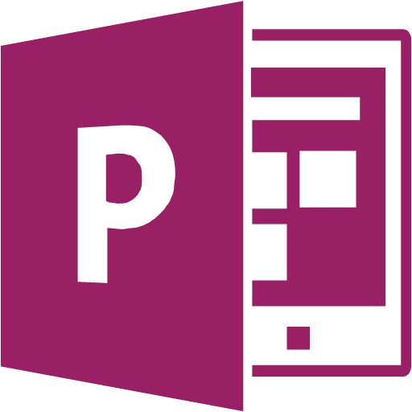




SharePoint Customizations Building Blocks
SharePoint PnP
Add-ins
SharePoint Framework
Flow
PowerApps
REST API
Column (View) Formatting
Webhooks
MS Graph
Site Designs & Site Scripts
@alexaterentiev | http://blog.aterentiev.com/ | Sharepointalist Inc.

Slide 12
SharePoint Customizations Building Blocks
Add-ins
SPFx
REST API
MS Graph
Webhooks
SharePoint PnP
Flow
SharePoint PnP
End users
Makers
Low-code developers
Pro developers
Column (view) Formatting
PowerApps
Site Designs & Site Scripts
SharePoint PnP
SharePoint PnP
@alexaterentiev | http://blog.aterentiev.com/ | Sharepointalist Inc.

Slide 13
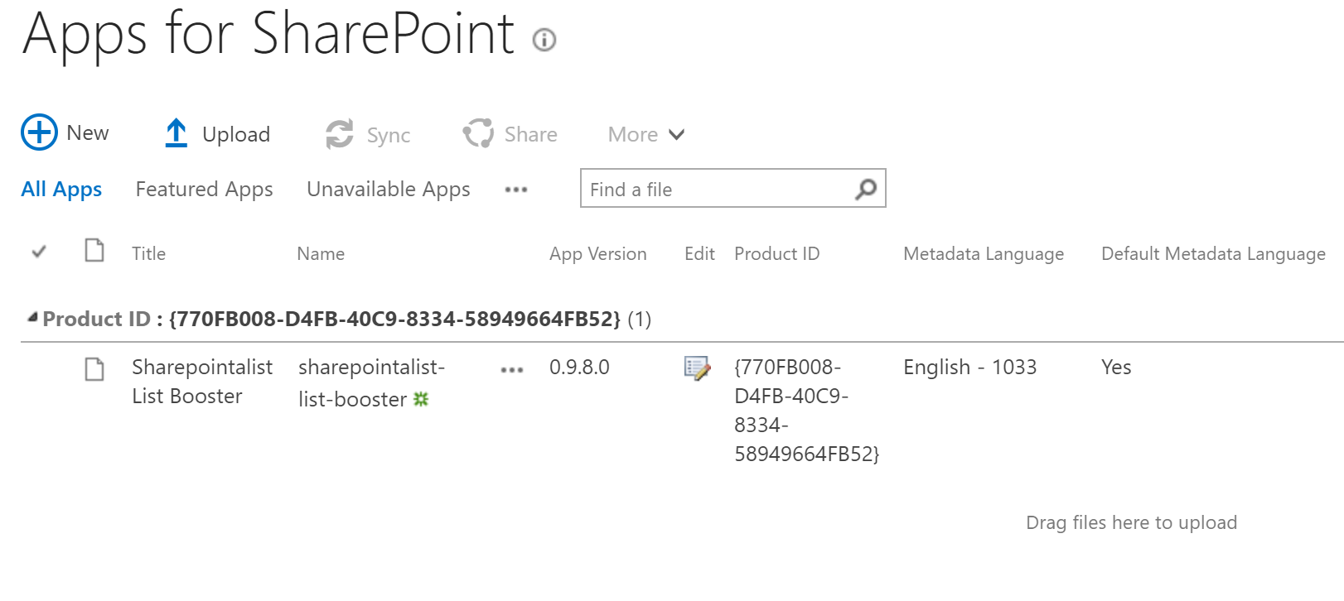
SharePoint Add-ins (Apps)
SPO
SP2019
SP2016
SP2013
A SharePoint Add-in is a self-contained, isolated piece of functionality that extends the capabilities of SharePoint websites to solve a well-defined business problem.
“Mature” model for SharePoint customizations – available since SharePoint 2013
Code must be hosted somewhere – “add-in” web in SharePoint (SharePoint-hosted), remote web app – Azure (Provider-hosted)
@alexaterentiev | http://blog.aterentiev.com/ | Sharepointalist Inc.

Slide 14
SharePoint Add-ins (Apps)
SPO
SP2019
SP2016
SP2013
SharePoint-hosted Add-ins
Centered around SharePoint components: lists, pages, web parts, etc.
No server-side code, client-side only
Code is isolated and “lives” in “add-in” web (except of provisioned SharePoint elements – Custom Actions, Lists, Content Types, etc.)
When/Where to use
Security considerations for “isolated” environment – the code runs in separate add-in web inside SharePoint
Requirements to distribute client-side solution through Office App Store
iframe love ☺
Provider-hosted Add-ins
Centered around remote web application or data source
Business logic is mainly remote server-side code usually hosted on Azure
Allow to “elevate” privileges
When/where to use
Requirements to elevate privileges
Complex server-side business logic
To connect with LOB applications
Resources
http://bit.ly/sp-addins
@alexaterentiev | http://blog.aterentiev.com/ | Sharepointalist Inc.

Slide 15
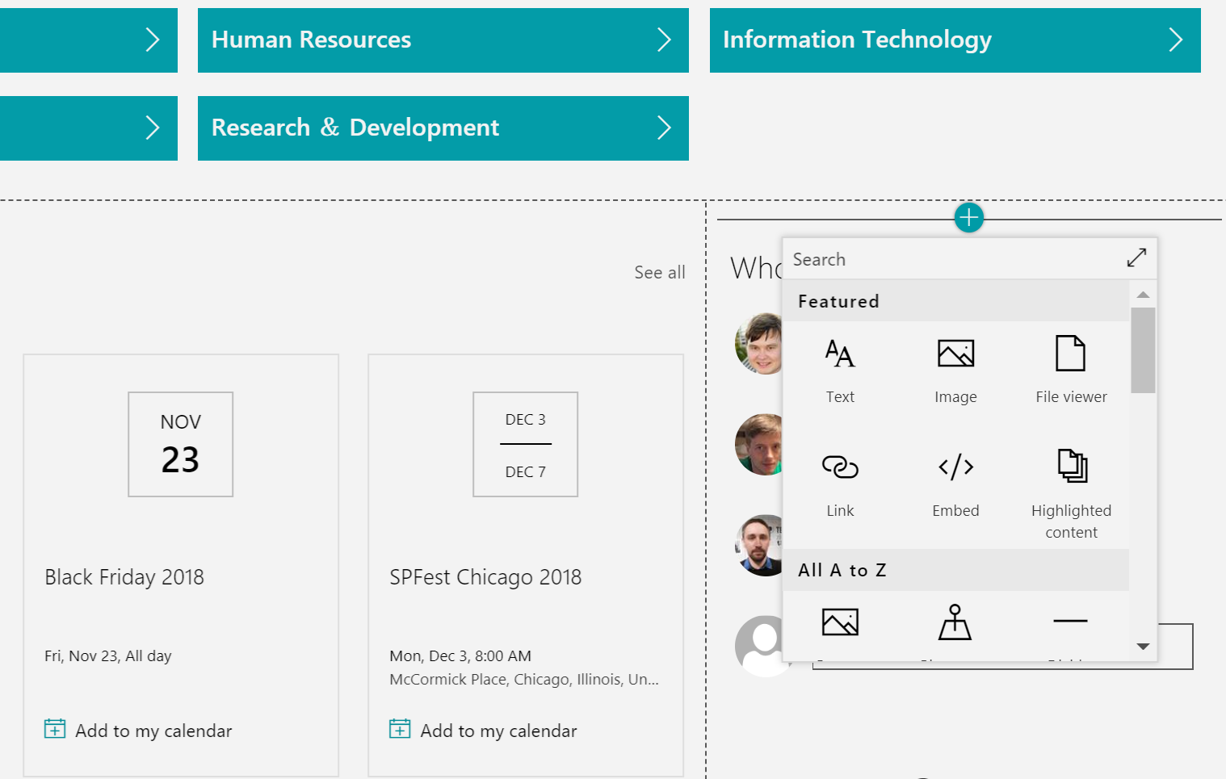
SharePoint Framework (SPFx)
SPO
SP2019
SP2016
The SharePoint Framework (SPFx) is an engine to develop SharePoint client-side customizations.
No server-side code, client-side only
Easy integration with SharePoint and O365 data in the code (OOTB helpers for REST API, MS Graph API)
Modern, mobile-first UI
Allows to include the latest and greatest from front-end world in SharePoint
Available in Microsoft Teams (client-side web parts)
Available customizations points:
Client-side web parts – controls that can be added to SharePoint pages and Teams tabs. Available on Modern and Classic pages
Extensions – allow to extend SharePoint user experience within Modern pages and lists/libraries. SP 2019, SPO
Application Customizer
Command Set Customizer
Field Customizer
Single part app page – non-editable page with single web part (SPO)
When/where to use
To customize/extend Modern SharePoint UI
Create modern client-side web parts
Business logic: client-side code + HTTP/REST requests,
notification hubs, message queues, etc.
Create app to work both in SharePoint and Microsoft Teams
Resources
https://aka.ms/spfx
https://github.com/SharePoint/sp-dev-docs
https://developer.microsoft.com/en-us/sharepoint/blogs/
Follow @SharePoint and @OfficeDev on Twitter
@alexaterentiev | http://blog.aterentiev.com/ | Sharepointalist Inc.

Slide 16
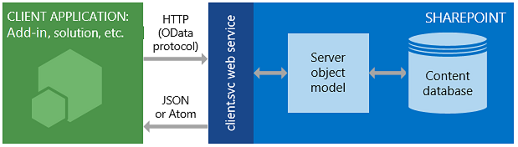
SharePoint REST API
SPO
SP2019
SP2016
SP2013
Set of REST endpoints to work with SharePoint data.
Ability to perform CRUD operations from any SharePoint customization (Add-ins, SPFx, custom scripts, etc.)
Requires requests to be authorized
If creating, updating and deleting requests are not authorized using OAuth access token then server’s request form digest (X-RequestDigest header) is required
Easy to use in JavaScript code – allows to request data in JSON format
When/where to use
Main scenario is to work with SharePoint data in client-side customizations, including SharePoint Framework
Custom external applications, including WebJobs, scripts, etc.
Resources
https://docs.microsoft.com/en-us/sharepoint/dev/sp-add-ins/get-to-know-the-sharepoint-rest-service
https://s-kainet.github.io/sp-rest-explorer
Source: Microsoft Docs
@alexaterentiev | http://blog.aterentiev.com/ | Sharepointalist Inc.

Slide 17
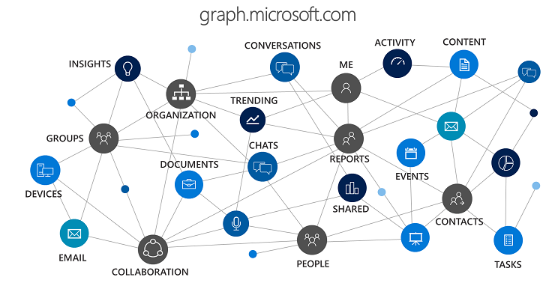
Microsoft Graph
SPO
Unified REST-ful API for Office 365 Resources (Users, Groups, Documents, Sites, etc.).
Allows to access various data throughout Office 365 ecosystem (now – including Dynamics)*
Allows to easily construct requests to access data of connected entities (e.g. User -> Calendar -> Meeting -> Attendees)
Requires acquired Azure AD access token and configured set of permissions (auth overview - https://developer.microsoft.com/en-us/graph/docs/concepts/auth_overview)**
When/where to use
Access Office 365 data
Perform ALM-cycle operations on O365 entities such as Groups, Teams, etc.
Resources
https://developer.microsoft.com/en-us/graph/docs/concepts/overview
https://developer.microsoft.com/en-us/graph/graph-explorer
https://developer.microsoft.com/en-us/graph/code-samples-and-sdks
https://github.com/microsoftgraph/msgraph-community-samples
*MS Graph is relatively new and may not contain some endpoints
**There is no need for access token if MS Graph is used from SharePoint Framework
Source: Office Dev Blog
@alexaterentiev | http://blog.aterentiev.com/ | Sharepointalist Inc.

Slide 18
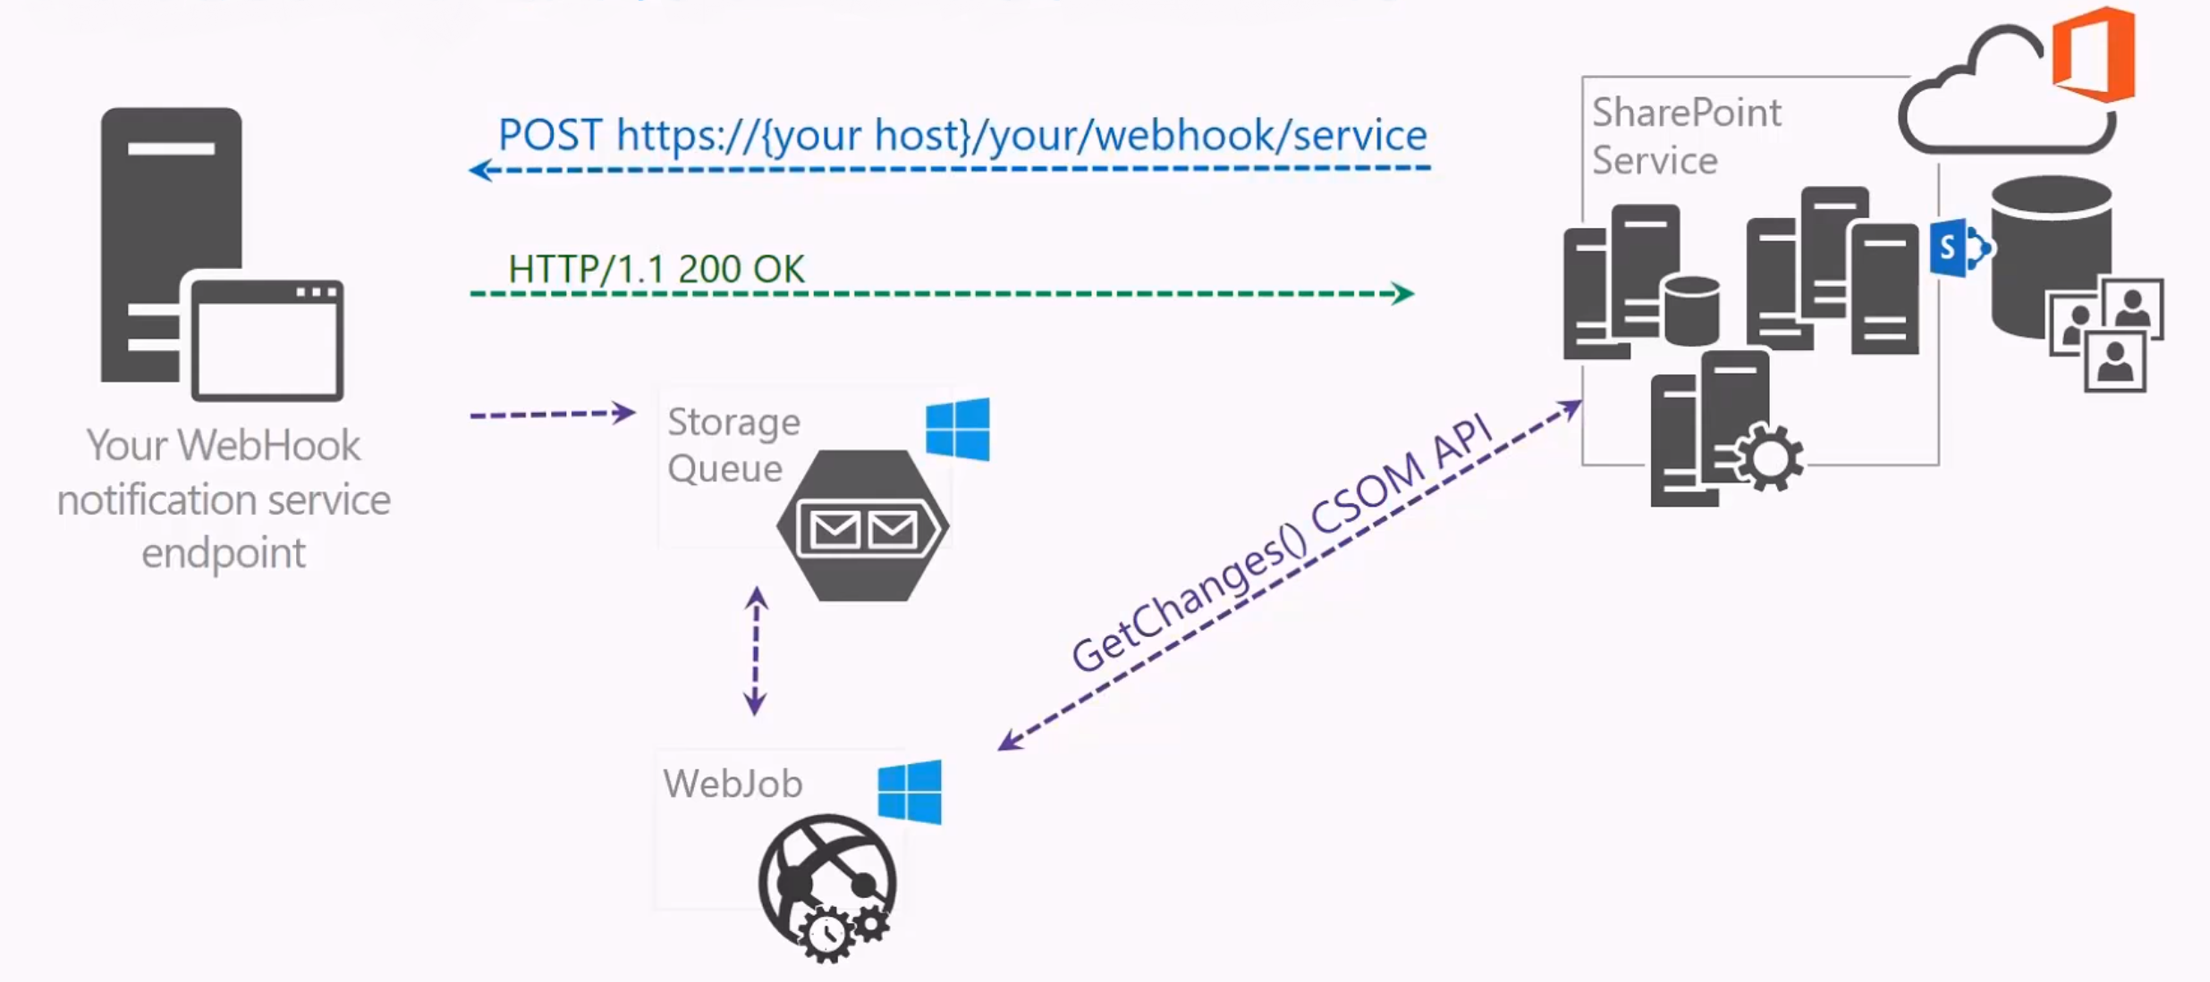
SharePoint Webhooks
SPO
SP2019
Enable developers to subscribe on specific events that occur in SharePoint with remote handlers.
Regular HTTP Service (web API) – easier than WCF
Every Webhook needs to be registered with Resource, Server notification URL and Expiration Date
Currently available for SharePoint list items events only, but
Cover a lot of items’ events (added, updated, checked in, attachment added, etc.)
When/where to use
Handle SharePoint List Item’s events
Resources
https://docs.microsoft.com/en-us/sharepoint/dev/apis/webhooks/overview-sharepoint-webhooks
Source: PnP Webcast
@alexaterentiev | http://blog.aterentiev.com/ | Sharepointalist Inc.

Slide 19
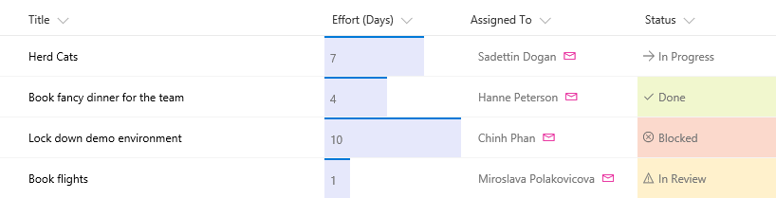
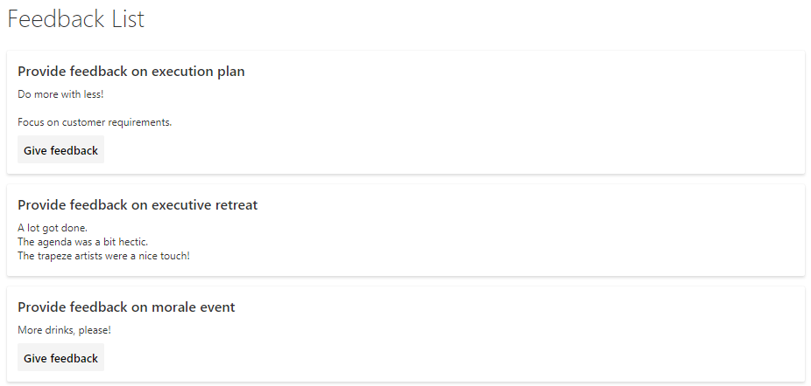
Column (View) Formatting
SPO
SP2019
Allows to change list columns’ and views’ appearance using JSON.
No code, no deployment
“Power Users” with expertise in JSON can apply formatting
OOTB SharePoint Feature with kind of UI available
When/where to use
Customize columns’ experience in list views: color-coding, KPIs, action links, etc.
Customize views’ experience
Resources
https://docs.microsoft.com/en-us/sharepoint/dev/declarative-customization/column-formatting
https://docs.microsoft.com/en-us/sharepoint/dev/declarative-customization/view-formatting
https://github.com/SharePoint/sp-dev-column-formatting
https://github.com/SharePoint/sp-dev-solutions/tree/master/solutions/ColumnFormatter
Source: Microsoft Docs
Source: Microsoft Tech Community
@alexaterentiev | http://blog.aterentiev.com/ | Sharepointalist Inc.

Slide 20
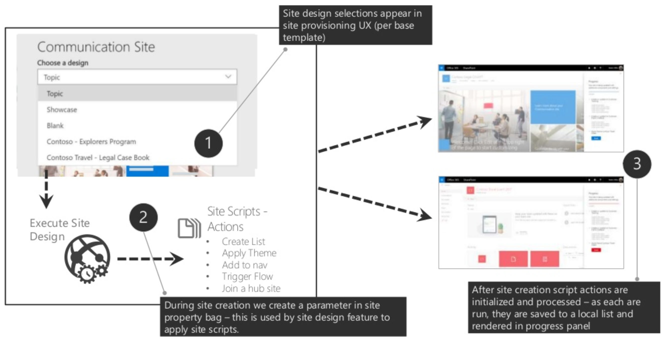
Site Designs & Site Scripts
SPO
Site designs and site scripts are used to automate provisioning of new or existing modern SharePoint sites using custom configurations.
Site Designs are like templates – can be used to apply a consistent set of actions each time when a new site is being created
Can be applied to already created modern sites
Site Design should be registered in SharePoint and tied to one of modern site types (Communication or Team Site)
Site Designs can be scoped to a selected users or groups
Site scripts are JSON files with ordered list of actions (apply theme, create list, add navigation, install solution from app catalog, call MS Flow, etc.)
Site Design can contain multiple site scripts that run sequentially
Site Designs and site scripts are created/registered using PowerShell and/or REST API
When/where to use
To apply custom theming/coloring to the sites
To apply SPFx extensions to the site
To provision custom content to the site
To create consistent site provisioning templates in the organization
Resources
https://aka.ms/spsitedesigns
https://github.com/SharePoint/sp-dev-site-scripts
https://ypcode.wordpress.com/2018/03/26/site-designs-studio-1-0
Source: PnP Webcast
@alexaterentiev | http://blog.aterentiev.com/ | Sharepointalist Inc.

Slide 21
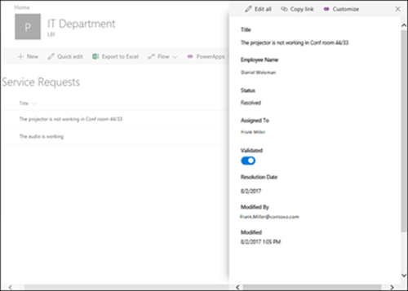
Microsoft PowerApps
SPO
SP2019
SP2016
SP2013
Service that lets you build business apps that run in a browser or on a phone or tablet, and no coding experience is required.
Not unique to SharePoint, used with other O365 apps
Allow to create mobile applications connected to SharePoint lists (On-prem and Online)
Allow to customize SharePoint list forms. SharePoint Online only
When/where to use
To create a custom mobile application with SharePoint list as a data source
To customize SharePoint list forms
Hidden gem – quick UI prototyping for POCs
Resources
https://docs.microsoft.com/en-us/powerapps/maker/canvas-apps/customize-list-form
https://support.office.com/en-us/article/create-a-powerapp-for-a-list-in-sharepoint-online-9338b2d2-67ac-4b81-8e67-97da27e5e9ab
https://web.powerapps.com/home
Source: Microsoft Docs
@alexaterentiev | http://blog.aterentiev.com/ | Sharepointalist Inc.

Slide 22
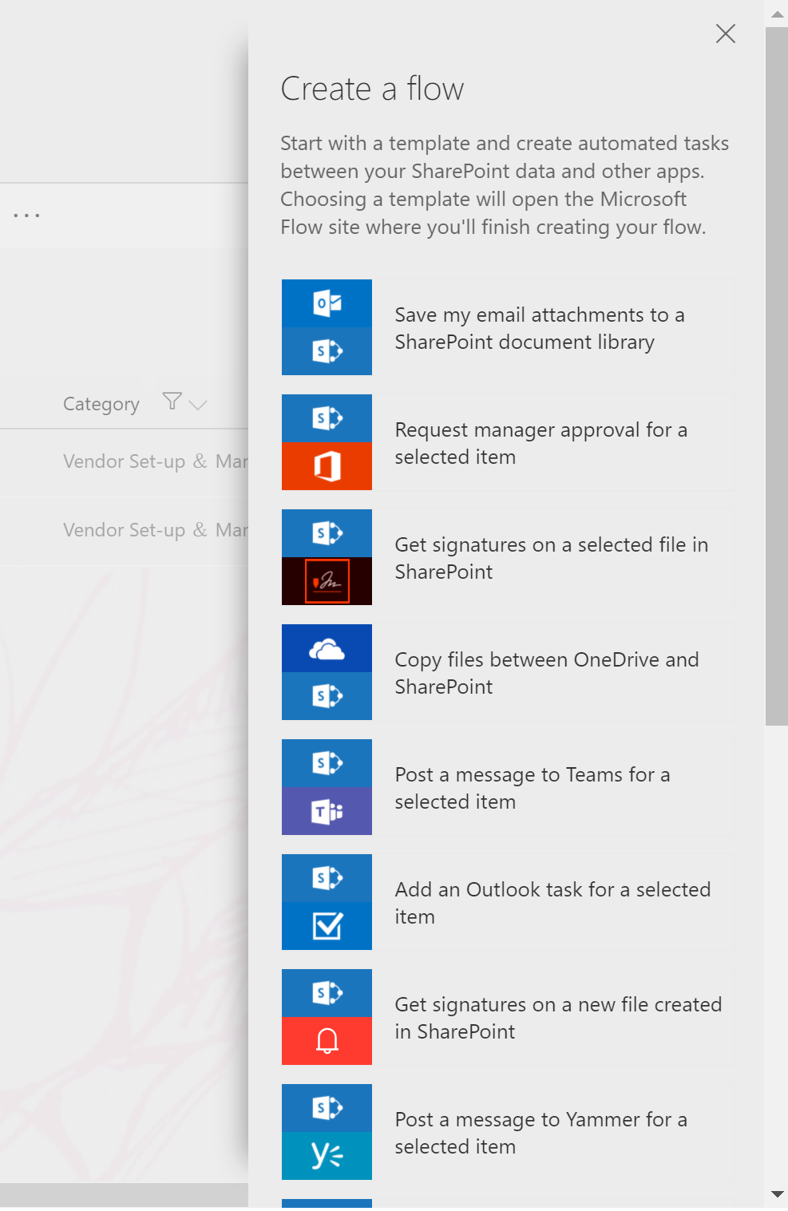
Microsoft Flow
SPO
SP2019
Service in Office 365 suite that allows to automate business processes by building workflows based on certain triggers and actions.
Allows to integrate SharePoint with other O365 apps (Outlook, OneDrive, Yammer, etc.) and external apps (Twitter, Dropbox, etc.)
Allows to call any HTTP endpoint
Contains large number of triggers from SharePoint
Not unique to SharePoint, used with other O365 apps
When/where to use
To create workflows for SharePoint list items, documents, pages, etc.
To implement easy-to-build integrations between SharePoint and other internal or external apps
Resources
https://flow.microsoft.com/en-us/
https://docs.microsoft.com/en-us/flow/
https://sharepointmaven.com/what-is-microsoft-flow/
https://flow.microsoft.com/en-us/blog/flow-in-spo-document-libraries/
https://veenstra.me.uk/2018/03/23/powerapps-and-microsoft-flow-things-you-cant-do-yet/
Follow @johnnliu and @PieterVeenstra on Twitter
@alexaterentiev | http://blog.aterentiev.com/ | Sharepointalist Inc.

Slide 23

SharePoint Patterns & Practices
SPO
SP2019
SP2016
SP2013
SharePoint Patterns and Practices (PnP) is an open source initiative coordinated by SharePoint engineering. It’s a set of resources on top of SharePoint to simplify SharePoint administering and development.
Currently SharePoint PnP = SharePoint Dev Ecosystem
Covers most of the commonly used scenarios around SharePoint
Expands SharePoint OOTB development and administering tools
Provides tons of helpful materials including blogs, podcasts, learning videos
Provides official documentation and guidance on modern SharePoint development
Consolidates and thrives the community
Selective parts of PnP:
PnP Core
PnPJS
PnP PowerShell
SharePoint Dev Solutions
SharePoint Framework reusable controls
SharePoint Online Provisioning Service
PnP Yeoman Generator
When/where to use
Everywhere!
Resources
https://aka.ms/sppnp
https://github.com/SharePoint
https://github.com/PnP
https://www.youtube.com/channel/UC_mKdhw-V6CeCM7gTo_Iy7w
https://developer.microsoft.com/en-us/sharepoint/blogs/
@alexaterentiev | http://blog.aterentiev.com/ | Sharepointalist Inc.

Slide 24
Summary Table
Use.. | If you need to…
SharePoint-Hosted SharePoint Add Ins | Run client-side app in “isolated” environment Distribute client-sode app through Office App Store
Provider-Hosted SharePoint Add ins | Elevate priviliges Implement complex server-side business logic with access to SharePoint Context Connect SharePoint to LOB apps (look into SPFx as well)
SharePoint Framework | Customize/extend SharePoint Modern UI Create modern client-side web parts Connect SharePoint to LOB apps (using Azure App registration) Create apps available both in SharePoint & Microsoft Teams
SharePoint REST API | Access SharePoint data/artifacts from SharePoint customizations and custom apps
Microsoft Graph | Access data across Office 365 Perform ALM cycle operations on O365 entities
SharePoint Webhooks | Handle List Item’s events
Column (View) Formatting | Customize columns’ experience in list views: color-coding, KPIs, action links, etc. Customize rows’ experience – rolling out now…
Site Designs/Site Scripts | To create consistent site provisioning templates in the organization, including custom theming/coloring, navigation, SharePoint components, web parts, extensions, etc.
Microsoft Power Apps | Customize SharePoint List Forms Create custom mobile apps connected to SharePoint lists POC UI prototyping
Microsoft Flow | Create workflows for SharePoint list items, documents, etc. Implement easy-to-build integrations between SharePoint and other internal (O365) and external apps
SharePoint Patterns & Practices | Everywhere and always
@alexaterentiev | http://blog.aterentiev.com/ | Sharepointalist Inc.

Slide 25

Classic Tools
SPO
SP2019
SP2016
SP2013
SharePoint Publishing & Branding
Still in use for intranet branding
Supported in Classic Experience only
Look into Site Designs, Site Scripts, flexible modern pages layouts, and Application Customizer
SharePoint Designer
Used for master pages’ customizations, pages’ editing, workflows
Supported in Classic Experience only
Look into Application Customizer and Client-side web parts, Site Designs, flexible modern pages layouts, PowerApps, Microsoft Flow
Sandbox solutions (no server-side code)
Used for Custom Actions (ScriptLink, Ribbon, ECB, JSLink), provisioning of custom items (Fields, Content Types, etc.)
Custom Actions are supported in Classic Experience only
Look into SharePoint Framework Extensions, Feature Framework and Remote Provisioning techniques, including PnP Remote Provisioning
Content Editor Web Part and Script Editor Web Part
Used for injecting HTML content and JavaScript on the page directly
Supported in Classic Experience only
Look into Modern Script Editor Web Part my Mikael Svenson – https://github.com/SharePoint/sp-dev-fx-webparts/tree/master/samples/react-script-editor
@alexaterentiev | http://blog.aterentiev.com/ | Sharepointalist Inc.

Slide 26

Additional Tools
SPO
SP2019
SP2016
SP2013
Microsoft Azure (https://azure.microsoft.com/en-us/)
Hosting service – for Add-ins, Webhooks, WebJobs, etc.
Azure Functions – easy way to run small pieces of code in cloud. Ideal to integrate with Microsoft Flow, including Site Designs and Site scripts
Azure Queue Storage – to queue messages from SharePoint and perform actions for each of them
…and more
Office UI Fabric (https://developer.microsoft.com/en-us/fabric)
Official front-end framework to build UI that fits seamlessly in Office 365
SharePoint (and Office 365) UI is based on Office UI Fabric
Provides CSS styles, icons, typography, and components library – JavaScript and React*
Allows to focus on the functionality, not the look
SharePoint Framework Docker Image by Walder Mastykarz (https://blog.mastykarz.nl/sharepoint-framework-docker/)
Ready-to-use environment with SharePoint Framework toolchain installed
Allows to start SPFx development right away
Allows to have multiple versions of SPFx on developer’s machine for different projects
Extensible to the needs of a specific developer/team – https://blog.mastykarz.nl/sharepoint-framework-docker-image-your-team/
SPGo for Visual Studio Code (https://marketplace.visualstudio.com/items?itemName=SiteGo.spgo)
Allows to sync remote SharePoint folders (document libraries) with local workspace
All the configuration is stored in a config file that can be added to a source control
Publishes files to SharePoint on save
All strength of Visual Studio Code like IntelliSense, compare tools
#SharePoint, #SPFx, and #sphelp tags on Twitter
*There is also AngularJS community-driven version of components that has some known limitations
@alexaterentiev | http://blog.aterentiev.com/ | Sharepointalist Inc.

Slide 27
Q&A
@alexaterentiev | http://blog.aterentiev.com/ | Sharepointalist Inc.

Slide 28
Session Survey
http://bit.ly/spo-customization-toolset-survey
@alexaterentiev | http://blog.aterentiev.com/ | Sharepointalist Inc.

